Slide 1



ecx.io Frontend Bootcamp — Multimedia in HTML 05.07.2021.

Slide 2

Agenda
Recap of Friday Exercise
Images
[lunch break]
Audio and Video
Other embedding technologies

Slide 3


Recap of Friday Exercise

Slide 4
Friday exercise
Go over the blizzard careers website and create a structural outline using semantic elements.
URL: https://careers.blizzard.com/global/en
Go over the ecx.io website and create a structural outline using semantic elements.
URL: https://www.ecx.io/en
Pick a website of your choice, and create a structural outline using semantic elements.

Slide 5
Images in HTML

Slide 6
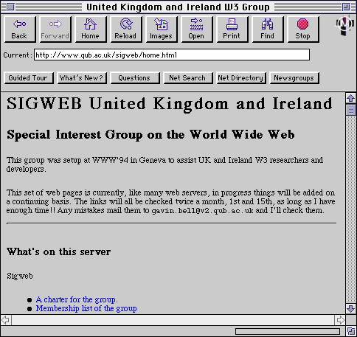
Images in HTML
In the old days, the Web was just about the text.
Luckily, there are possibilities to embed images (and other types of content) to web pages nowadays.
Source: http://www.agocg.ac.uk/reports/mmedia/handbook/hndbk3.htm

Slide 7
Images in HTML
<img> is an ”empty” element (no text content or closing tag)
Requires “src” attributes, as it contains path to the image we want to embed.

Slide 8
Images in HTML
Filenames should be descriptive, as they are used by search engines for better SEO results.
<img> is also called “replaced element” – an element which content and size are defined by an external resource.
Read more about replaced elements

Slide 9
Attributes
Source
Mandatory attribute which holds the actual location of the image.

Slide 10
Attributes
Alternative text
Used to describe the image textually
It is used when image cannot be loaded, or it takes a long time to load it because of old internet connection
Helpful to visually impaired users, as screen reader reads it

Slide 11
Attributes
Alternative text
If image used only for styling purposes, it is better to leave the “alt” empty
If image used inside a link, the link still has to have accessible link text, either inside the “a”, or as an “alt” on the image

Slide 12
Attributes
Width and height
Size can be specified via attributes.
If the image is not loaded, the browser will leave the “reserved” space for the image.
However, image size shouldn’t be restricted through HTML, but rather through CSS. We can mess up the aspect ratio or size, and then image looks wrong.

Slide 13
Attributes
Title
Title can be added to image as for other elements, to provide further supporting information if needed.
Gives a tooltip on mouse hover.

Slide 14
Exercises
Add the following image to html file.
Describe the image with alternative text. If you misspell the image URL, verify the alternative text is shown.
Add width and height to the image. Note: original size: 200x171
Add the title to it.
https://raw.githubusercontent.com/mdn/learning-area/master/html/multimedia-and-embedding/images-in-html/dinosaur_small.jpg

Slide 15
Figures and captions

Slide 16
Figures and captions
There are many ways to add a caption to the image
It contains the content we need, can be nicely styleable using CSS
But, where is the connection between the caption and the image?

Slide 17
Figures and captions
We should use <figure> and <figcaption> elements
They exist exactly for this purpose: to provide a semantic container for figures, and to clearly link the figure and the caption.
“caption” – benefits even the people who can see the image
“alt” – provides the description in case the image is not loaded
=> They shouldn’t be the same content, as they both appear when the image is gone
Figure can contain other content except images, like code spinet, audio, video, or something else

Slide 18
Exercises
Wrap the image from previous example into a figure.
Copy the text out of the “title” attribute as caption, and remove the “title” attribute.

Slide 19
Responsive images

Slide 20
Responsive images
Images that work well on devices with different screen sizes or resolutions.
With them, we can show different images on different viewports.
This also helps us with performance optimization, as we won’t load large image on mobile phones.

Slide 21
Responsive images
With them, we solve two problems:
Resolution switching – serving small images to narrow screen devices as they don’t need huge images like desktop. Additionally, we can serve different resolution images to high/low density screens
Art direction – displaying different image for different screens, focusing on the important part of image, rather than just changing the resolution of image

Slide 22
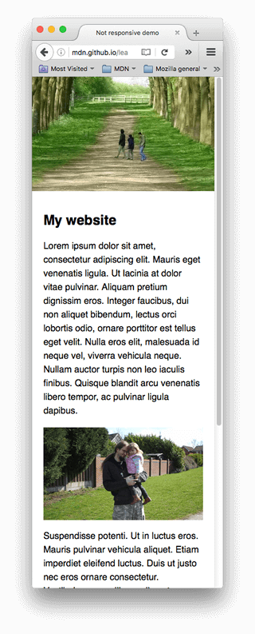
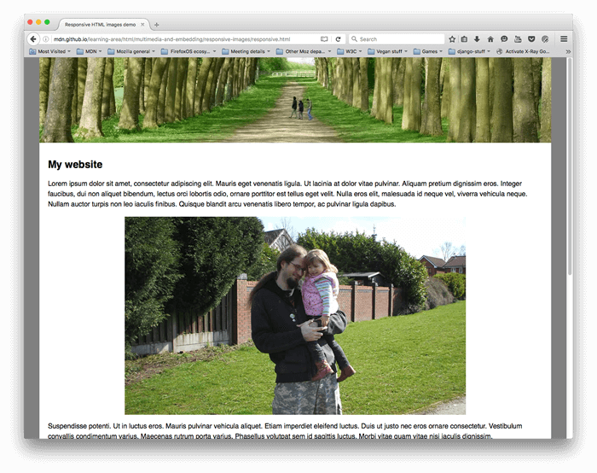
Resolution switching
Source: https://developer.mozilla.org/en-US/docs/Learn/HTML/Multimedia_and_embedding/Responsive_images

Slide 23
Resolution switching
We want to display identical image content, just larger (or smaller), depending on the screen size.

Slide 24
Resolution switching
“srcset” and “sizes” attributes
srcset
Defines the set of images we allow browser to choose between, and the size each image is.
image filename
a space ☺
image’s width in pixels (note the usage of “w” unit)

Slide 25
Resolution switching
“srcset” and “sizes” attributes
sizes
Defines the set of media queries and indicated which image size would be the best to choose.
media query (when the viewport is of that width)
a space ☺
the width of the slot the image will fill when the media query is true

Slide 26
Resolution switching
“srcset” and “sizes” attributes
What browser does?
Look at its device width
Work our which media query in the sizes list is the first that is true
Look at the slot size of same media query
Load the image referenced in the srcset that has the same size as the slot, or first bigger one

Slide 27
Exercise
Create an HTML file which will hold a blog post containing an image. We want to show the image in same way, but just with different sizes on different viewports, in order to save network traffic.
Viewport definitions: - 640px - load the image-xs.png - 1024px - load the image-sm.png - 1400px - load the image-l.png
Note: add the following styles to your HTML, so that it's easier to check correct images:
img { width: 100%; }

Slide 28
Resolution switching
Multiple resolutions, same real-world size on the screen
“sizes” is not needed
Browser works out the resolution based on the screen resolution

Slide 29
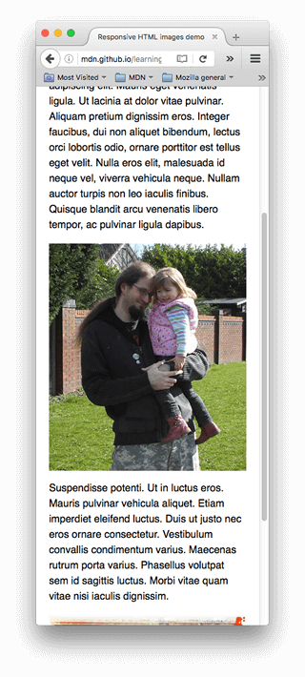
Art direction
Source: https://developer.mozilla.org/en-US/docs/Learn/HTML/Multimedia_and_embedding/Responsive_images

Slide 30
Art direction
We want to display different image content, depending on the screen size.
For this, we can use <picture> element.

Slide 31
Art direction
<picture>
Wrapper element that contains:
- several <source> elements, which provide different sources.
- <img> element

Slide 32
Art direction
<source>
Element that represents a different sources.
Attributes:
- “media” – media query, based on which browser decides which resource to load
- “srcset” – path to the image
<img> has to be provided at last, as it provides a default case that applies when none of the media queries are valid.

Slide 33
Exercises
To the previous exercise, add additional image. This time, we want to present a different image (with different aspect ratios) for different viewports: - 640px - load the picture-xs.jpg - 1024px - load the picture-sm.jpg - 1400px - load the picture-l.jpg

Slide 34
Audio and Video

Slide 35
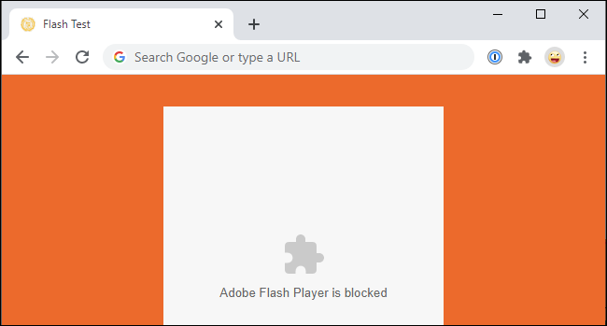
Audio and Video
Before a standard, video and/or audio could be embedded on a web page using plugin-based technologies, like “Flash” or “Silverlight”.
This worked ok-ish, but also had number of problems with compatibility.
Fortunately, in the HTML 5 specification, we got <video> and <audio> attributes support.
Source: https://www.howtogeek.com/707830/how-to-use-adobe-flash-in-2021-and-beyond/

Slide 36
Video

Slide 37
Video
<video> element allows us to embed a video very easily
“src” – similar as for the images, contains a path to the video
“controls” – in order to show the video controls, the attribute has to be specified. Alternative is to build an own interface using JavaScript.
“<p>” inside the video is the fallback content that will be displayed if the browser does not support <video>

Slide 38
Video formats
Different browsers support different video (and audio) formats.
We can use <source> element inside to provide different formats.
“type” attribute is optional, but it is a good practice to include it, as it helps browsers to understand the MIME type of the file specified.
Notes:
MIME = Multipurpose Internet Mail Extensions

Slide 39
Video attributes
width, height – control the video size
autoplay – starts the video after initial load
loop – vido plays from start once it’s finished
muted – video plays with sound turned off
poster – the URL of image which is displayed before the video is played
preload – buffering large files
none – does not buffer the file
auto – buffers the file
metadata – buffers only the metadata

Slide 40
Exercises
1. Include the following video to your page
- add fallback message to it - add poster image to it - set width and height to it - set the video to play in a loop, and to be muted initially
2. Try different values of `preload` attribute, and verify when the video is loaded.
Video: https://github.com/mdn/learning-area/blob/gh-pages/html/multimedia-and-embedding/video-and-audio-content/rabbit320.webm
Poster: https://github.com/mdn/learning-area/blob/gh-pages/html/multimedia-and-embedding/video-and-audio-content/poster.png

Slide 41
Audio

Slide 42
Audio
<audio> works just like the video, with some small differences
It does not support width and height attributes
It does not support poster attribute
All other attributes from video are supported

Slide 43
Exercises
Include the following audio to your page
- add source to the element - add fallback message to it - add attributes to play the audio initially, and in a loop
Audio: https://github.com/mdn/learning-area/blob/gh-pages/html/multimedia-and-embedding/video-and-audio-content/viper.mp3

Slide 44
Other embedding technologies

Slide 45
Other embedding technologies
Besides standard approach, there are possibilities to embed a wide variety of content types to webpages.
For this, we can use <iframe>, <embed> and <object> elements.
<iframe> allows us to embed other web pages.
<embed> and <object> allow us to embed different types of files, like PDFs.

Slide 46
Iframe
Designed to embed other web documents.
Attributes
src – URL of the document to embed
width/height – size we want the iframe to have
allowfullscreen – iframe can be placed in fullscreen mode using Fullscreen API
sandbox – applies additional security restrictions

Slide 47
Iframe
Security concerns
Iframes are common target of hackers
Only embed when necessary
Use HTTPS
Use “sandbox” attribute to restrict as much as possible. See more info here.

Slide 48
Exercises
Create an HTML page. After that, go to youtube and find a video of your choice. Use the “embed” option and paste the iframe to your page.
Embed a website of your choice to the same HTML page.

Slide 49
Embed and object
Unlike iframe, with those we can embed external content, like PDFs, or flash, videos, images.
Both <embed> and <object> will use the browser’s plugin for displaying the type of the file specified.
This should be used with caution. In most of the cases it is better to link a PDF file, than to embed it.

Slide 50
Exercises
Create an HTML page. After that, embed the PDF file called “awesome-document.pdf” to the page. Try it out with both <embed> and <object> elements.

Slide 51
References
https://developer.mozilla.org/en-US/docs/Learn/HTML/Multimedia_and_embedding/Images_in_HTML
https://developer.mozilla.org/en-US/docs/Learn/HTML/Multimedia_and_embedding/Responsive_images
https://developer.mozilla.org/en-US/docs/Learn/HTML/Multimedia_and_embedding/Video_and_audio_content
https://developer.mozilla.org/en-US/docs/Learn/HTML/Multimedia_and_embedding/Other_embedding_technologies

